Slide 1
Windows XP
Memory Management
Cody Baker
cody@codybaker.org

Slide 2
The Basics
Paging
  2 tier page table (1024x1024 on x86)
  Per process FIFO
  Default minimum working set of 50
    Adjusted on the fly, based upon availability and frequency of page faults.
  Pre-fetches near-by pages.
  Zeroed pages are transparently allocated by memory manager when a process accesses an address that doesn’t have a page.

Slide 3
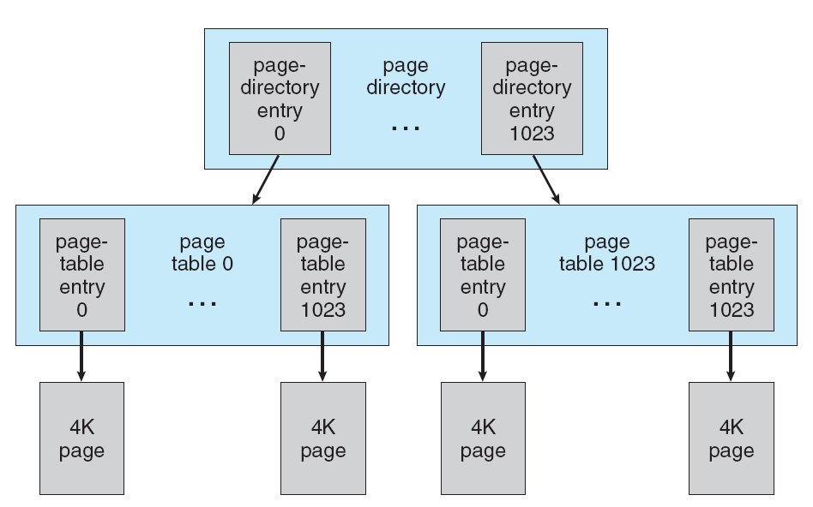
Multilevel Page Table

Slide 4
Pages
4k on x86, 8k on IA64
Page States
  Valid – in use
  Zeroed – ready for immediate use.
  Free – not referenced
  Modified – dirty
  Standby – unmodified copy of on disk page.
  Bad – hardware error
  Transition – on its way to the disk.

Slide 5
Types of Pages
Copy on Write
Memory Mapped Files
No-access page – can be placed after a page to detect buffer overflows.

Slide 6
From a Processes Prospective
4gb of address space for each process (8TB on 64-bit versions)
Upper 2gb primarily reserved for interface with operating system.
  Page Table Self Map
  Hyperspace
  Session Space – Shared amongst all processes on Terminal Server Space/Drivers Interfaces.
  Option to push to 4gb, but severely restricts caching.

Slide 7
Other Stuff
Support for PAE – Page Address Extensions
  Requires API called AWE – Addressing Window Extensions

Slide 8
References
Operating System Concepts, 7th Edition
Abraham Silberschatz, Yale University
Peter Baer Galvin, Corporate Technologies
Greg Gagne, Westminster College
Microsoft Technet
  support.microsoft.com
  msdn.microsoft.com

